Slide 1

Store Sales Dataset
Analysis

Slide 2

Our Team
Shokri Mohamed
Mustafa Abdelhalim
Alaa Mahmoud
Mohamed Alanani
Doha Ezzat
Yasmeen Hammad

Slide 3
1. Introduction and Overview
Dataset Overview
Data Exploration
Data Cleaning
Data Modeling
Visualization Dashboards
Conclusion
Recommendations
Agenda

Slide 4
Introduction
Project Idea:
An interactive data analytics project that provides clear insights into sales performance, customer behavior, and shipping efficiency using Power BI, Python, and Excel. The dashboard helps decision-makers identify trends, evaluate performance, and optimize business strategies based on real data.
Project Scope:
Sales Performance – Identify top-selling products, categories, and regions.
Customer Insights – Segment customers by purchasing behavior.
Shipping Analysis – Assess delivery performance and detect inefficiencies.
Regional Trends – Compare sales performance across locations.

Slide 5
Overview
Project Goal:
The goal of this project is to transform raw, unstructured sales data into meaningful, actionable business insights through a complete data analytics workflow. This includes exploring and cleaning the dataset using Python and Excel, creating optimized data models, and building an interactive Power BI dashboard that enables decision-makers to monitor performance, identify trends, and solve key business problems. By automating manual analysis and presenting insights visually, the project aims to support faster, more accurate, and data-driven decision-making across the business.

Slide 6
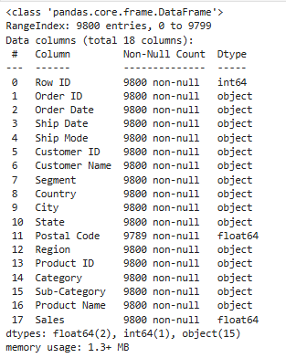
Dataset Overview
Dimensions: 9,800 rows and 18 columns, providing a rich transactional history.
Key Data Points: Order details, customer information, product specifics, sales figures, and shipping information.

Slide 7
Data Fields Description
Column Name | Description
Row ID | A unique identifier for each row in the dataset.
Order ID | A unique identifier for each order placed.
Order date | The date when the order was placed.
Ship date | The date when the order was shipped.
Ship mode | The method is used for shipping (e.g., Standard, Express).
Customer ID | A unique identifier for each customer.
Customer name | The full name of the customer.
Segment | The customer’s category (e.g., Consumer, Corporate, or Home Office).
Country | The country where the order was placed.
Column Name | Description
City | The city where the order was placed.
State | The state or province of the order’s location.
Region | Geographical regions (e.g., East, West, Central, South).
Product ID | A unique identifier for each product.
Category | The highest-level product classification (e.g., Furniture, Office Supplies). Used for high-level sales trends.
Sub-Category | A more specific product grouping within the main Category (e.g., Chairs, Phones). Used for detailed performance analysis.
Product Name | The specific name of the item purchased. Used for identifying top-selling individual products.
Sales | The revenue generated from the transaction (base sale price). The primary metric for financial performance.

Slide 8
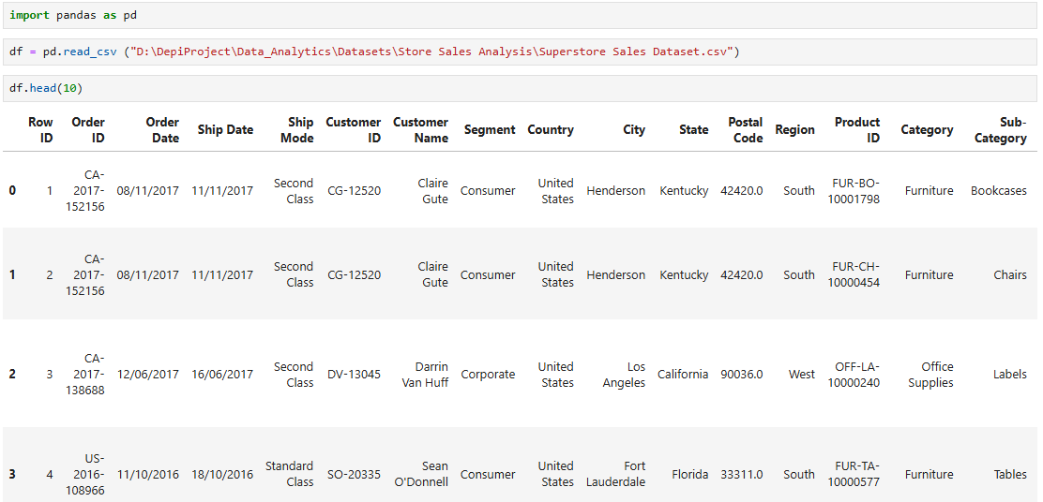
Data Exploration

Slide 9
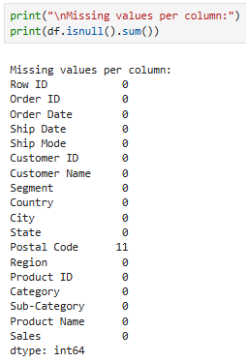
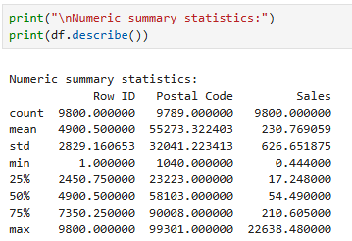
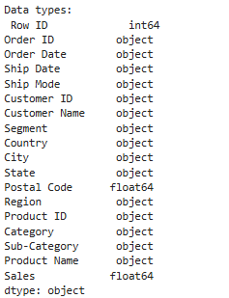
Data Exploration

Slide 10
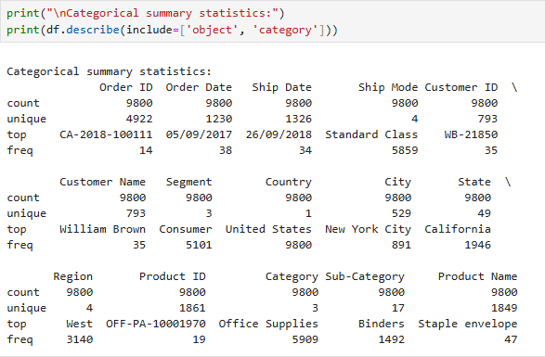
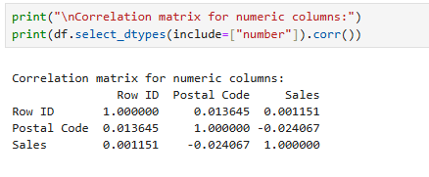
Data Exploration
A correlation matrix shows how strongly numerical variables are related to one another. In this dataset, the correlations are all very close to zero, which indicates very weak relationship between the numeric columns:
Row ID and Sales: 0.001 → No meaningful relationship
Postal Code and Sales: –0.024 → No meaningful relationship
Row ID and Postal Code: 0.013 → No relationship
This means that none of these numeric fields influence each other directly, and they can be treated as independent variables in analysis.

Slide 11
Challenges in Original Datasets
Data Type Inconsistencies
Missing & Inconsistent Values
Order Date and Ship Date columns in superstore dataset are not in a standard date-time format, complicating time-series analysis.
The Postal Code column was stored as a float64 numeric type, which caused issues such as the loss of leading zeros and incorrect interpretation of the values as numerical rather than categorical data. This resulted in inaccurate postal code representation and hindered proper analysis, filtering, and grouping within the dataset.
Null values in Postal Code column.

Slide 12
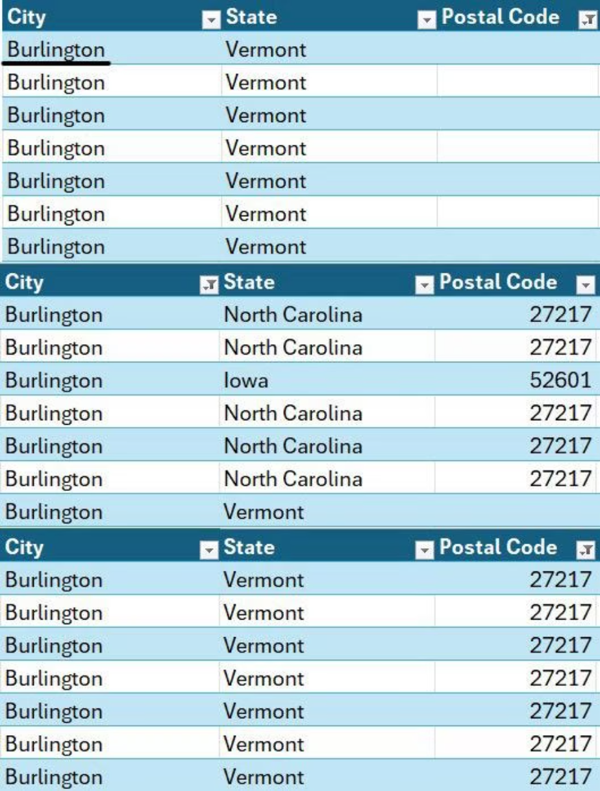
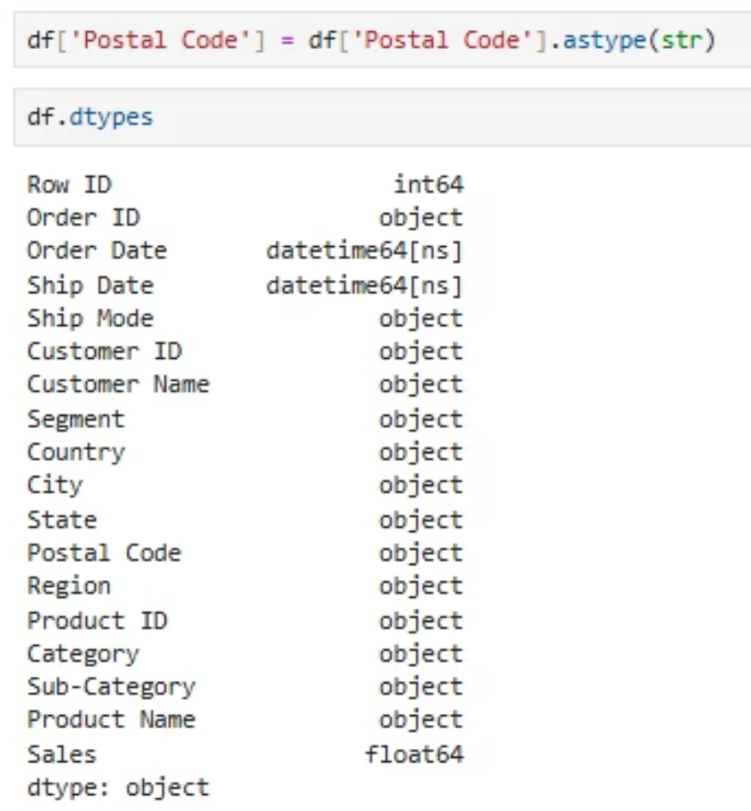
Data Cleaning
Postal Code Cleaning: Ensuring Data Integrity
Addressing inconsistencies in postal code data for accurate geographic analysis.
Python Transformation
Excel Missing Value Imputation
Converted the 'Postal Code' column from a float64 numeric type to a string format to preserve leading zeros and ensure proper categorical handling.
Filled any missing postal code values by identifying the most frequent postal code associated with its corresponding 'City' to maintain data consistency.

Slide 13
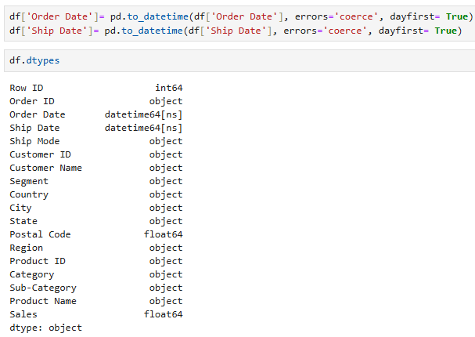
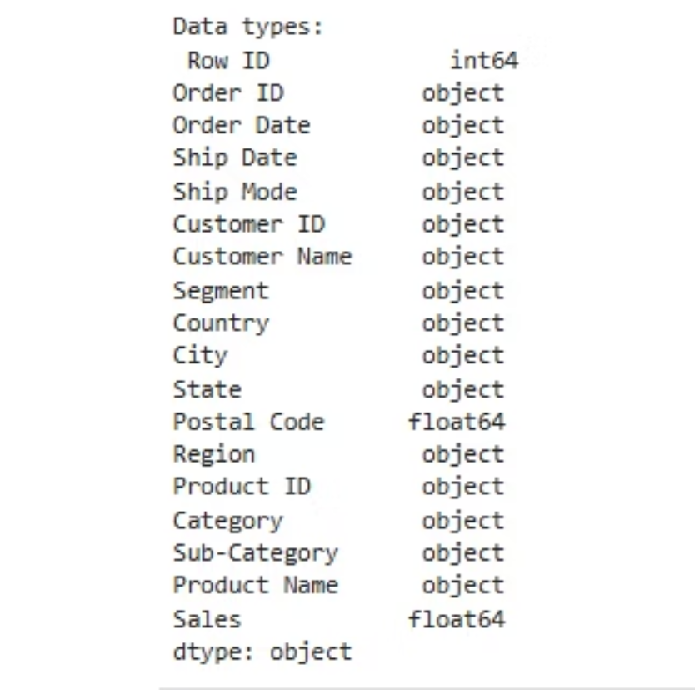
Data Cleaning
Date Field Conversion: Enabling Time-Series Analysis
Transforming 'Order Date' and 'Ship Date' from text to datetime objects for comprehensive time-based insights.
The Challenge
The Solution: Python Datetime Conversion
Initially, 'Order Date' and 'Ship Date' were stored as generic 'object' (text) types. This format prevents any meaningful temporal calculations or trend analysis.

Slide 14
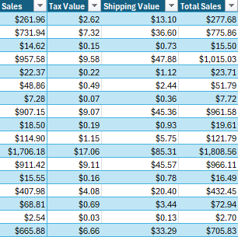
Data Cleaning
Sales Enhancements: Adding New Columns & Formatting
Expanding the 'Sales' data with calculated financial metrics and consistent currency formatting.
Calculated Columns
Tax Value: 1% of Sales
Shipping Cost: 5% of Sales
Total Sales: Sales + Tax + Shipping
Currency Formatting
Applied consistent dollar sign formatting to all relevant financial columns within Excel for clarity and readability.
Sales
Tax Value
Shipping Value
Total Sales

Slide 15
Data Modeling

Slide 16
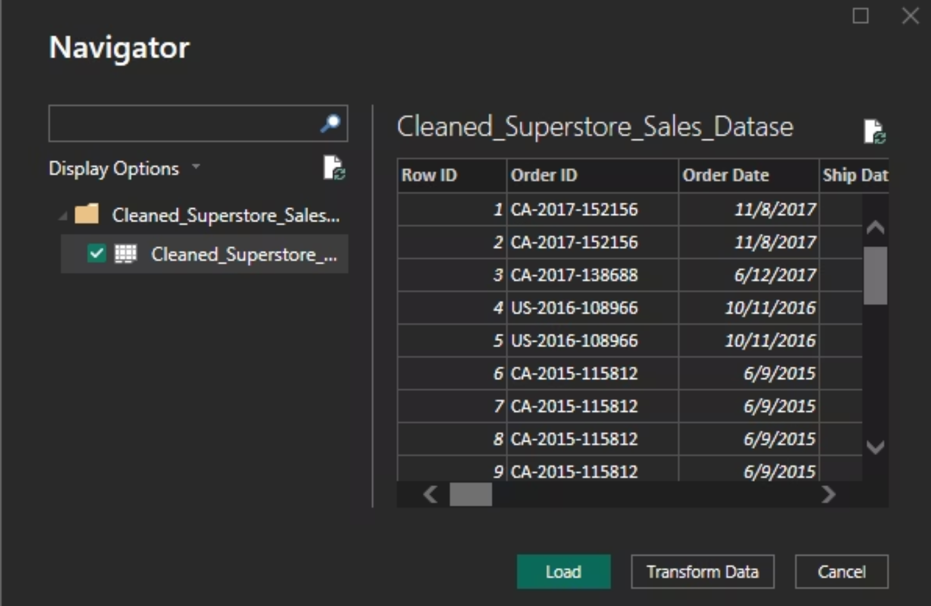
Data Modeling in Power BI: Step 1 - Data Import
Bringing our cleaned and enhanced Excel data into Power BI for analysis.
Seamless Data Ingestion
The first crucial step in building our robust data model is to import the prepared Excel workbook directly into Power BI. This ensures all the cleaning and enhancements are carried forward.

Slide 17
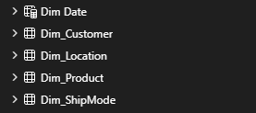
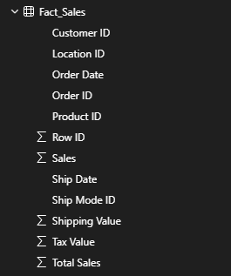
Data Modeling: Step 2 - Data Transformation
Structuring our data into Dimension and Fact Table using Power Query for optimal analytical
performance.
Dimension Tables
Fact Table
Fact_Sales: Centralizes key transactional data and foreign keys
linking to dimensions.
Dim Date
Dim_Customer
Dim_Location
Dim_Product
Dim_ShipMode

Slide 18
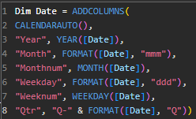
Dimension Tables: The Building Blocks of Context
Detailed attributes for each key entity, providing rich context for sales analysis.
Dim_Customer
Dim_Location
Dim_Product
Customer ID (PK)
LocationID (PK)
Product ID (PK)
Customer Name
City, State
Product Name
Segment
Postal Code, Country
Category, Sub-Category
Region
Dim_ShipMode
Dim Date
Date (PK)
Year
Month
MonthNum
Weekday
WeekNum
Quarter
Ship Mode ID (PK)
Ship Mode

Slide 19
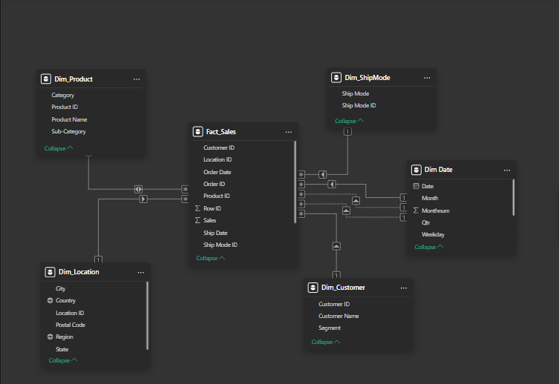
Final Data Model – Superstore Sales

Slide 20
Visualization Dashboards

Slide 21
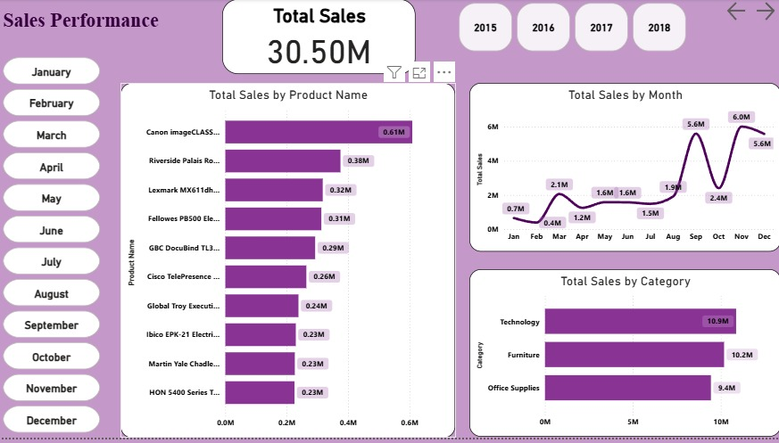
Visualization Dashboards

Slide 22
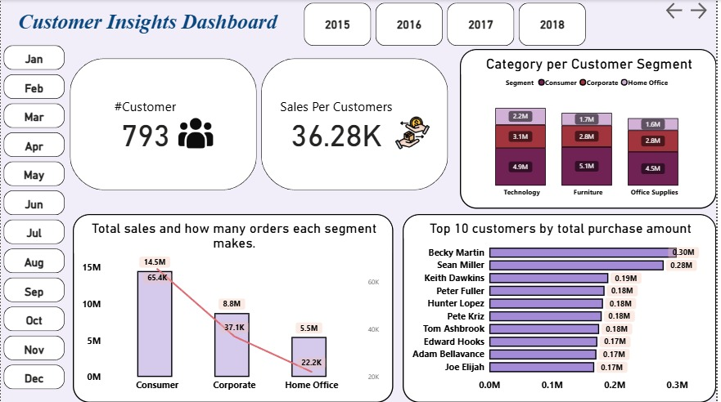
Visualization Dashboards

Slide 23
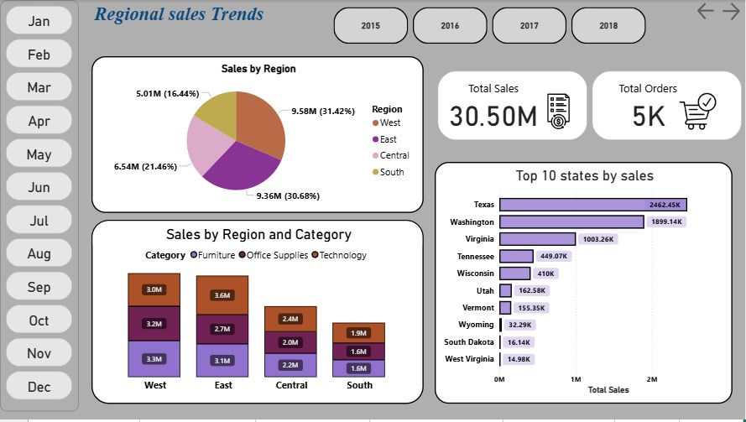
Visualization Dashboards

Slide 24
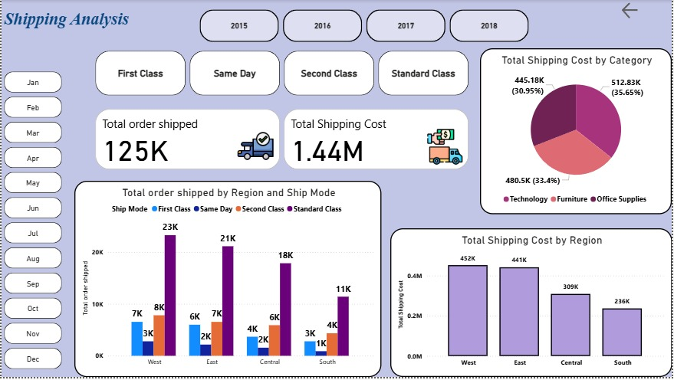
Visualization Dashboards

Slide 25
Conclusion

Slide 26
Conclusion
The SuperStore dashboards provide a comprehensive overview of:
The Store's Sales Performance
Customer Insights
Regional Sales
Shipping Analysis
Consumer segment Analysis of the key performance indicators (KPIs) reveals several important insights:
1- Sales Performance 3- Regional Sales
2- Customer Insights 4- Shipping Analysis

Slide 27
Conclusion
Consumer segment Analysis of the key performance indicators (KPIs) reveals several important insights:
1-Sales Performance
Monthly sales indicate strong peaks in August and December, suggesting seasonal demand at specific times of the year.
Office Supplies contributes the least
The Technology category represents the highest total sales
Regionally, the West and South markets achieve the highest sales, while other regions show potential for growth.
3- Order Analysis:
2- Product Performance:

Slide 28
Conclusion
Consumer segment Analysis of the key performance indicators (KPIs) reveals several important insights:
2-Customer Insights
The Consumer segment is the largest contributor to total sales.
The top 10 customers generate a significant portion of revenue.
The top customer exceeding $0.30M
98% of customers are repeat buyers.
3- Order Analysis
:

Slide 29
Conclusion
Consumer segment Analysis of the key performance indicators (KPIs) reveals several important insights:
3- Regional Sales
A significant portion of sales is concentrated in a limited number of states
The West region demonstrates strong overall sales performance, particularly within the Technology and Office Supplies categories.
Texas and Washington emerging as the strongest markets in terms of total sales
Although the West is the strongest region, the Central and South regions show a more equal distribution of sales across product categories, suggesting greater consumption diversity.

Slide 30
Conclusion
Consumer segment Analysis of the key performance indicators (KPIs) reveals several important insights:
4- Shipping Analysis
The total shipping cost reached $1.44 million
The Standard Class shipping mode is the most common choice among customers.
The Technology category bears the highest shipping costs.
Shipped orders are heavily concentrated in the West and East regions.
11/20/2025

Slide 31
Recommendations

Slide 32
Recommendations
Seasonality & Marketing: Move 45–50% of the entire yearly marketing budget to Q4.
Product Portfolio: Create a “Hero Products” list (top 50 SKUs) and give them 80% of promotions, homepage space, and bundles.
Customer Concentration: Immediately launch a VIP/Key Account program for top 50 customers (personal manager, exclusive offers).
Shipping & Costs: Raise free shipping threshold from the current level to $149–$199.
Geographic Focus: Allocate 40%+ of marketing to West + run Texas-specific campaigns (local ads, influencers).

Slide 33


